Slide 1
Post-quantum Public Key Cryptosystem (PKC) (Code-based)
Lake Bu
ASCS Lab

Slide 2
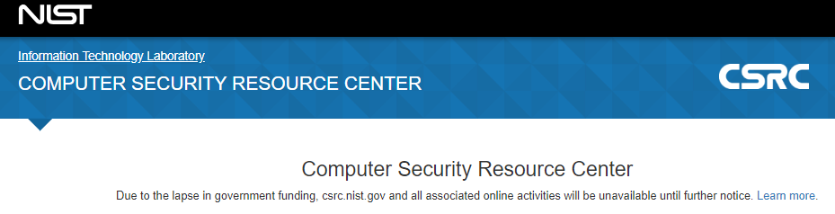

NIST is Closed
[1] https://csrc.nist.gov/projects/post-quantum-cryptography/round-1-submissions

Slide 3
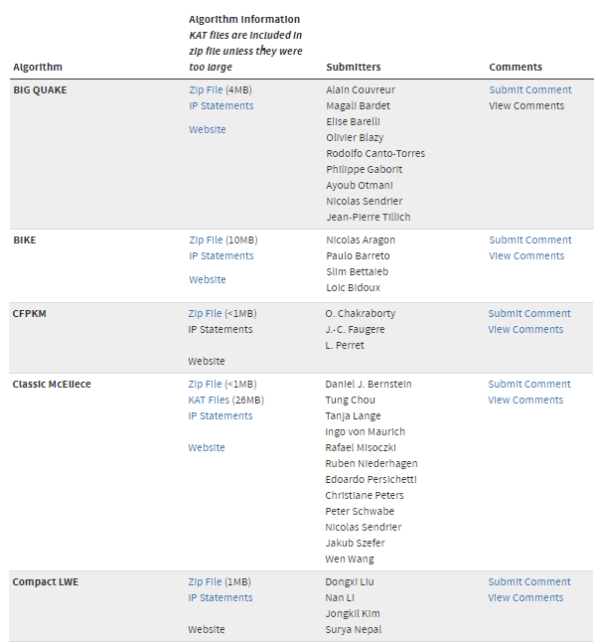
1. Post-Quantum Cryptography (PQC) Standardization
NIST
Jan 2017 - present
Evaluating 69 (5 withdrawn) submissions of PQC, to bring up a standard (just like AES):
21 lattice-based
18 code-based
Some hash-based
Some others
[1]
Submission deadline Nov 30, 2017. List updated Dec 17, 2018.
[1] https://csrc.nist.gov/projects/post-quantum-cryptography/round-1-submissions

Slide 4
Why Code-based?
Ring-LWE only being out for 5.5 years and has not withstood the test of time
The security reduction (hardness) is a modification of SVP & CVP
On the safe side, code-based cryptosystem (published in 1978, 40 years of examination) can be used, although:
Its key size is large: 1MB
Its decryption is highly parallel: easy for both good & bad guys
Don't put all eggs in one basket?
[1] Oded Regev et. al., On Ideal Lattices and Learning with Errors Over Rings, 06/2013

Slide 5
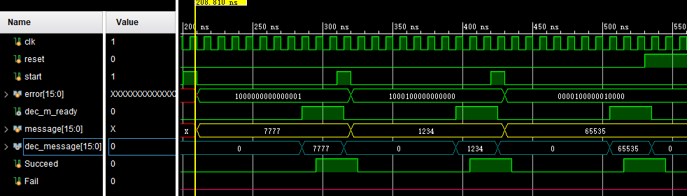
Code-based Encryption
Simulation successful
Able to encrypt & decrypt 16-bit plaintexts

Slide 6
Code-based Encryption
Simulation successful
Able to encrypt & decrypt 16-bit plaintexts

Slide 7
Code-based Encryption
McEliece cryptosystem
Error Correction Code (ECC)
A (n, k, t) ECC code C:
k: size of your message (information)
n: size of the encoded message (codeword)
t: # of random errors C can tolerate

Slide 8

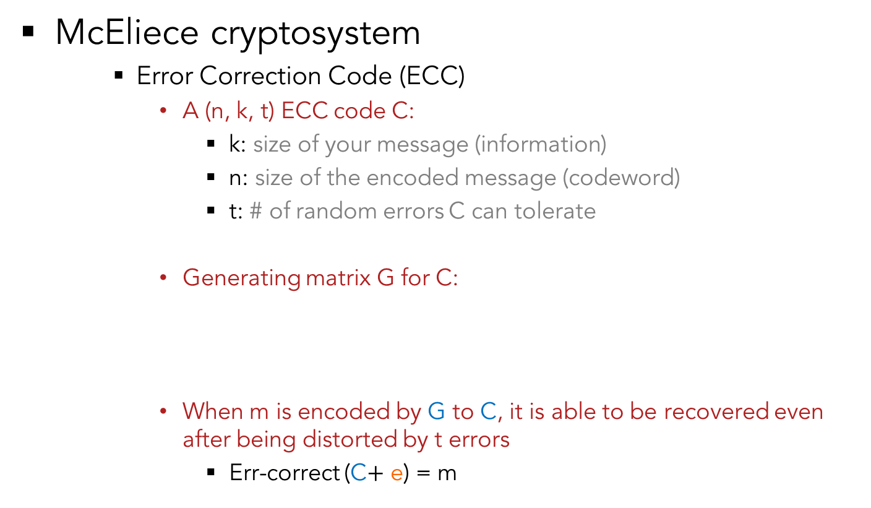

Code-based Encryption
McEliece cryptosystem
Error Correction Code (ECC)
A (n, k, t) ECC code C:
k: size of your message (information)
n: size of the encoded message (codeword)
t: # of random errors C can tolerate
Generating matrix G for C:
When m is encoded by G to C, it is able to be recovered even after being distorted by t errors
Err-correct (C$+$ e) = m
C
1
n
G
n
$$×$$
k
k
$$=$$
1
m

Slide 9
Code-based Encryption
McEliece cryptosystem
Error Correction Code (ECC)
A (n, k, t) ECC code C:
k: size of your message (information)
n: size of the encoded message (codeword)
t: # of random errors C can tolerate
Generating matrix G for C:
When m is encoded by G to C, it is able to be recovered even after being distorted by t errors
Err-correct (C$+$ e) = m
C
Nothing secret to anyone.
1
n
G
n
$$×$$
k
k
$$=$$
1
m

Slide 10




Code-based Encryption
k
Key Generation (Alice)
Pick two random matrices:
k$×$k non-singular binary matrix S:
n$×$n permutation binary matrix P:
Compute:
k$×$n matrix G’ = S$×$G$×$P
s
k
P
n
n
s
G
P
G’
$$×$$
$$×$$
$$=$$

Slide 11

Code-based Encryption
Key Generation
Public key (t, G’):
t,
Private key (S, G, P):
Remember G’ = S$×$G$×$P
G’
s
G
P

Slide 12
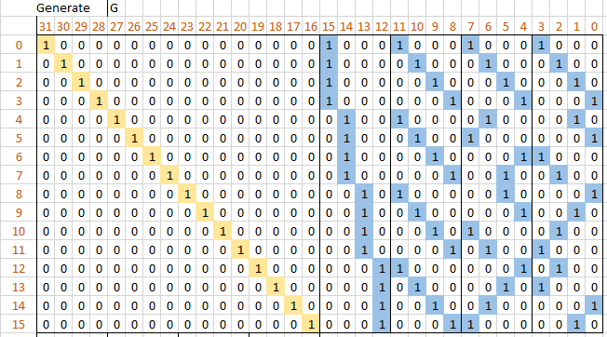
Code-based Encryption
G (the private key)
From a t= 2 double error-correcting OLSC code

Slide 13
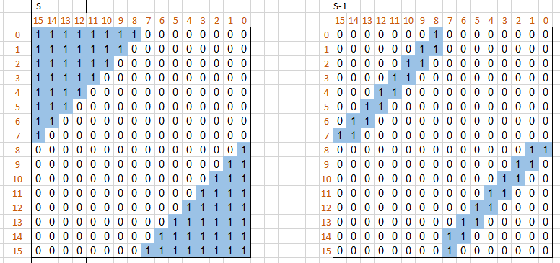
Code-based Encryption
S and its inverse (the private key)

Slide 14
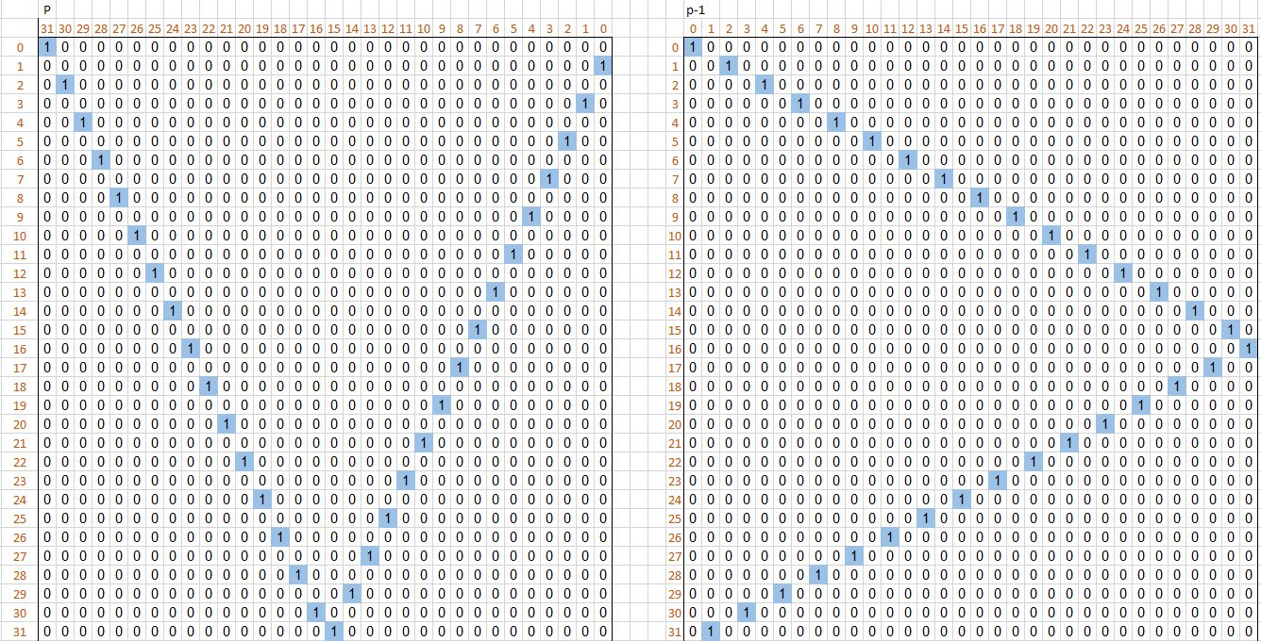
Code-based Encryption
P and its inverse (the private key)

Slide 15
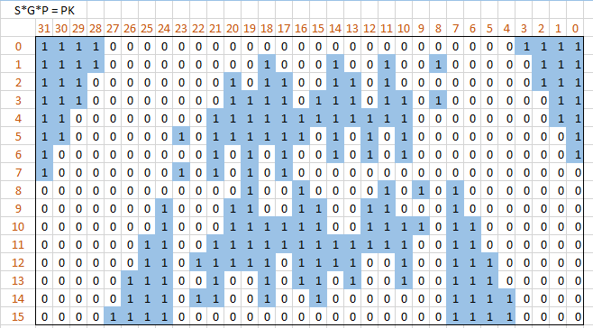

Code-based Encryption
G’ = S$×$G$×$P the public key

Slide 16
Code-based Encryption
Key Generation
Public key (t, G’):
t,
Private key (S, G, P):
Remember G’ = S$×$G$×$P
G’
s
G
P

Slide 17





Code-based Encryption
Encryption (Bob to Alice)
Message (plaintext) encrypted to codeword
C
G’
$$×$$
m
$$=$$
7777
$$×$$
$$=$$

Slide 18




Code-based Encryption
Encryption (Bob to Alice)
Message (plaintext) encrypted to codeword
Codeword obfuscated by error to cipher
C
e (t of 1’s)
Cipher
$$+$$
$$=$$
$$+$$
$$=$$

Slide 19


Code-based Encryption
Decryption (Alice)
(Remember G’ = S$×$G$×$P)
Cipher$×$P⁻¹ = (m$×$G’$+$ e) $×$P⁻¹ = (m$×$S$×\text{G}\text{)}+$ (e$×$P⁻¹)
$$×$$
=

Slide 20

Code-based Encryption
Decryption (Alice)
(Remember G’ = S$×$G$×$P)
Cipher$×$P⁻¹ = (m$×$G’$+$ e) $×$P⁻¹ = (m$×$S$×\text{G}\text{)}+$ (e$×$P⁻¹)
Err-correct (m $×\text{S}×\text{G}+$ (e$×$P⁻¹)) = m $×\text{S}$
Err-correct ( )
^, &, +, > ?

Slide 21


Code-based Encryption
Attacker does not know: S, G, P
Thus he/she cannot compute:
S⁻¹, Err-correct( ), P⁻¹
Therefore, he/she does not know m
Decryption (Alice)
(Remember G’ = S$×$G$×$P)
Cipher$×$P⁻¹ = (m$×$G’$+$ e) $×$P⁻¹ = (m$×$S$×\text{G}\text{)}+$ (e$×$P⁻¹)
Err-correct (m $×\text{S}×\text{G}+$ (e$×$P⁻¹)) = m $×\text{S}$
m $×\text{S}×\text{S}\text{−1}$ = m
7777
m
$$×$$
=
=

Slide 22
Code-based Encryption
Simulation successful
Able to encrypt & decrypt 16-bit plaintexts

Slide 23
Code-based Encryption
Simulation successful
Able to encrypt & decrypt 16-bit plaintexts

Slide 24
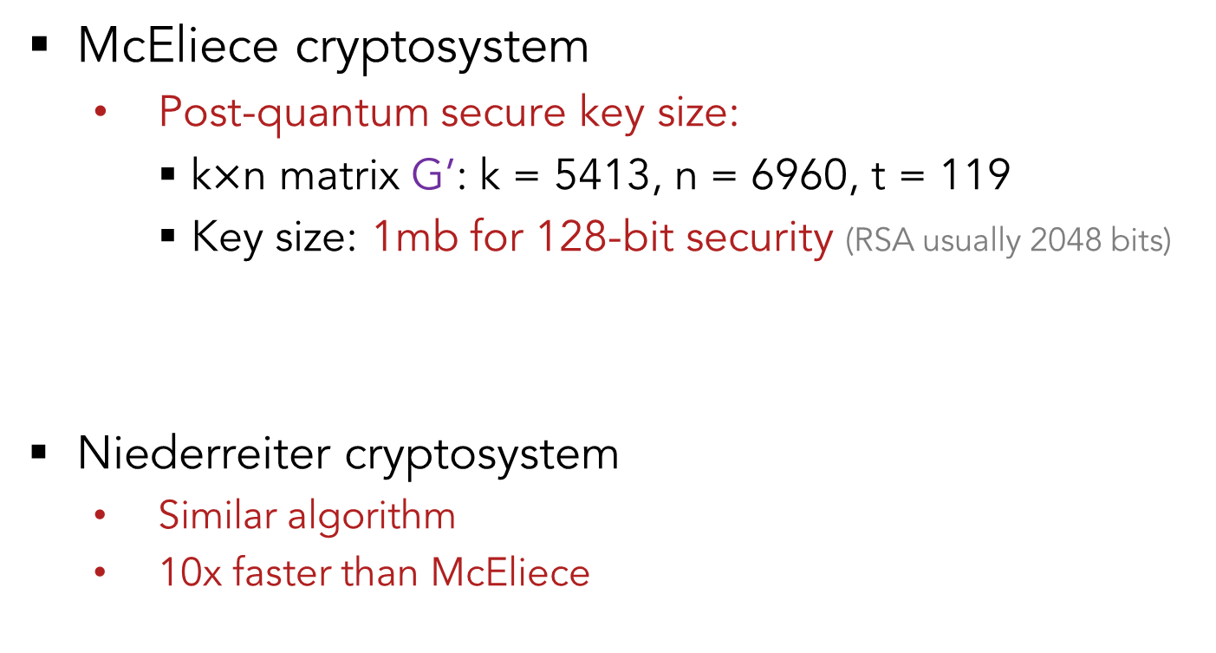
Code-based Encryption
McEliece cryptosystem
Post-quantum secure key size:
k$×$n matrix G’: k = 5413, n = 6960, t = 119
Key size: 1mb for 128-bit security (RSA usually 2048 bits)
Niederreiter cryptosystem
Similar algorithm
10x faster than McEliece
G’

Slide 25

Any Questions?

